Slide 1
Green option for milk packaging
Department of Computer Engineering
Presented by : GHOSH NILOY NEMAI (LEADER)
GUPTA AAYUSH
CHAURASIA PRASHANT
CHAUHAN RAJEEVKUMAR
Guide: Mrs Alka Srivastava
Mentor : Mrs Neelam Phadnis

Slide 2
Index
Abstract
Motivation
Objectives
Introduction
Literature Survey
Features of Proposed system
Proposed Architecture
Expected Results and Discussion
Conclusion
References

Slide 3
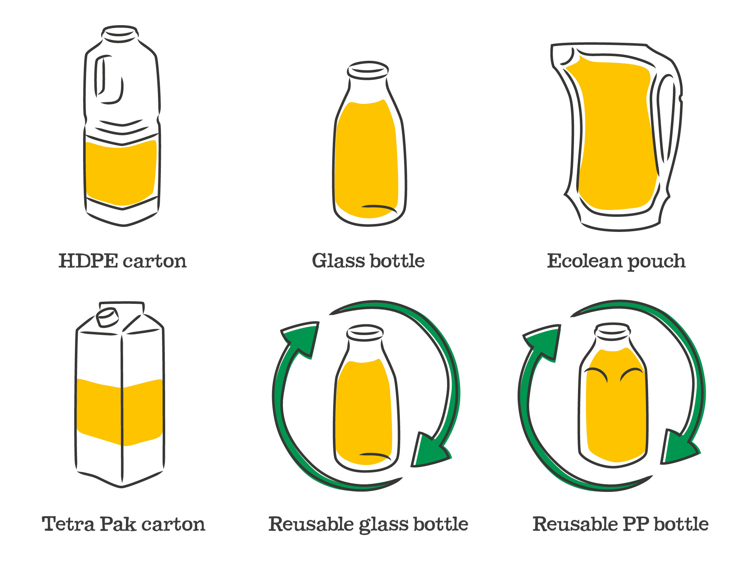
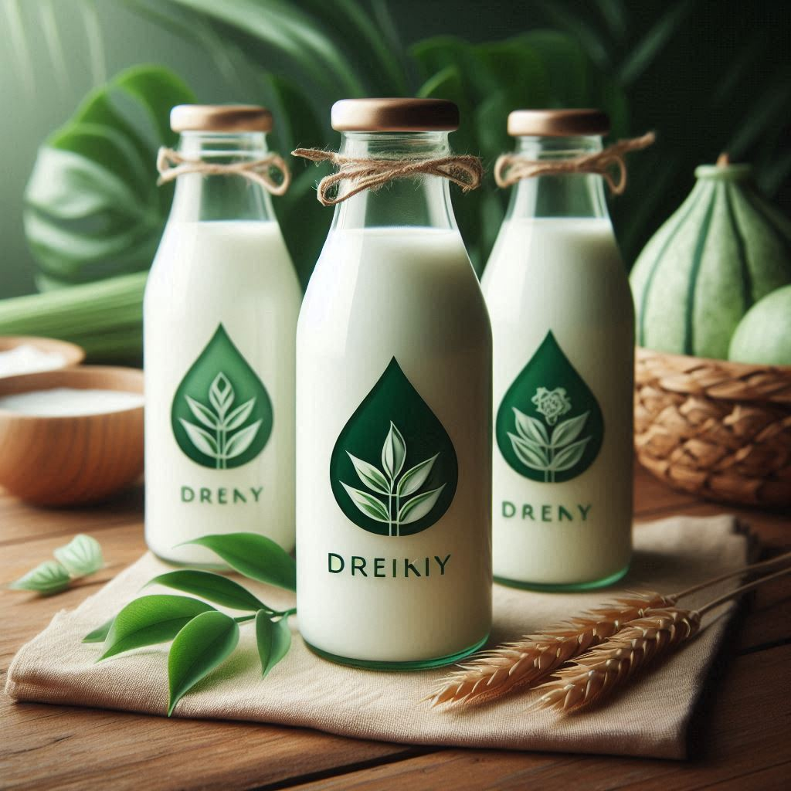
Abstract
We’re exploring better ways to package milk that are kinder to the environment. We looked into various eco-friendly options and found that biodegradable and recyclable materials
We investigated various green materials and approaches, including:
Biodegradable Materials
Recyclable Materials
Reusable Packaging

Slide 4
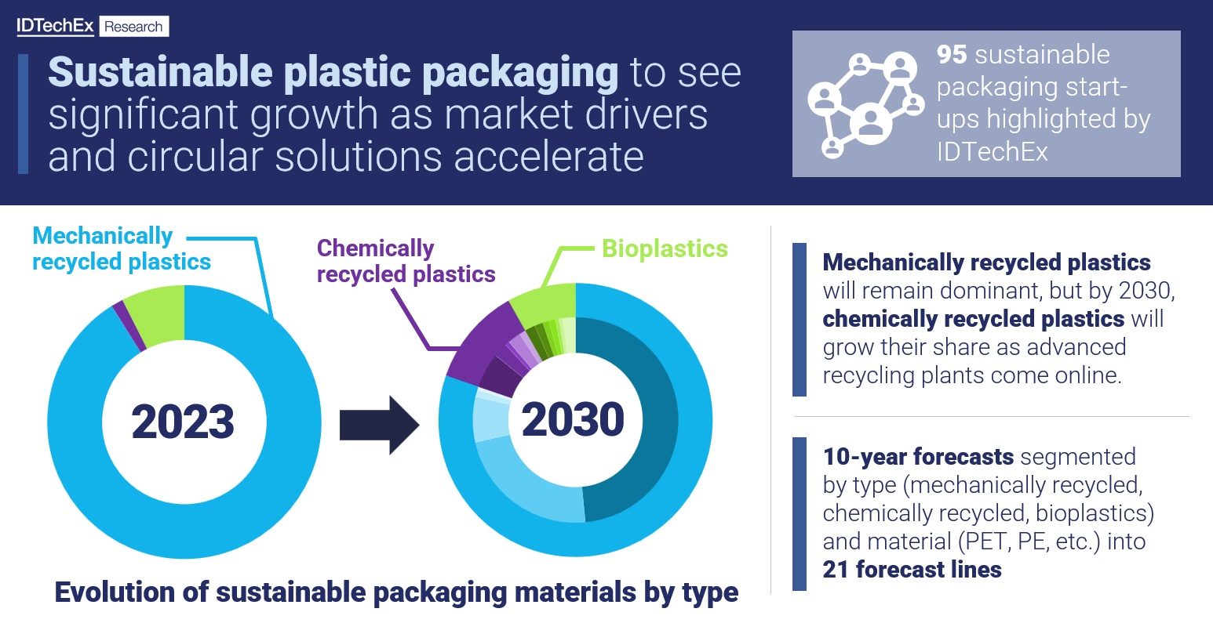
Motivation Environmental Impact: Traditional packaging creates significant waste. Demand: Growing preference for eco-friendly products. Economic Opportunities: The shift towards sustainable packaging can open new market opportunities

Slide 5
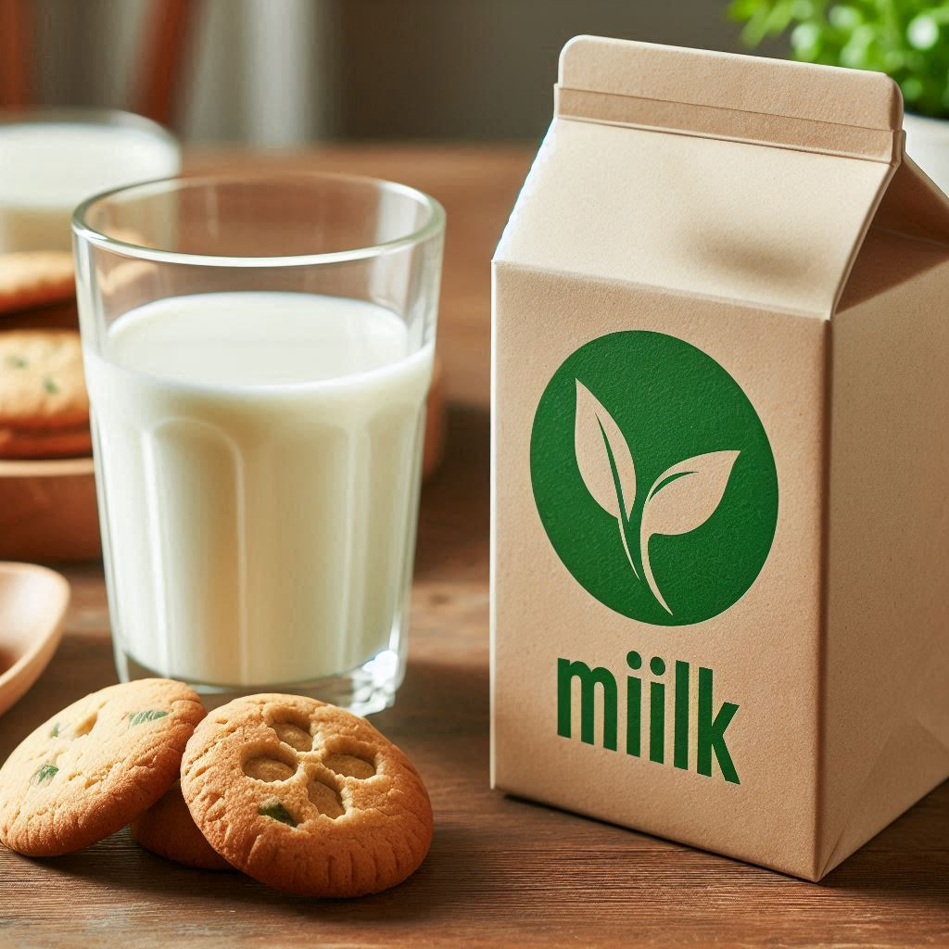

Objectives: Main Goal: Find and recommend the best eco-friendly packaging options for milk, which is including glass as a packaging option. Cost Analysis: Compare the costs of using sustainable packaging versus traditional packaging to see if it’s financially practical. Consumer Preferences: Find out what customers think about new packaging options and whether they’re willing to switch.

Slide 6
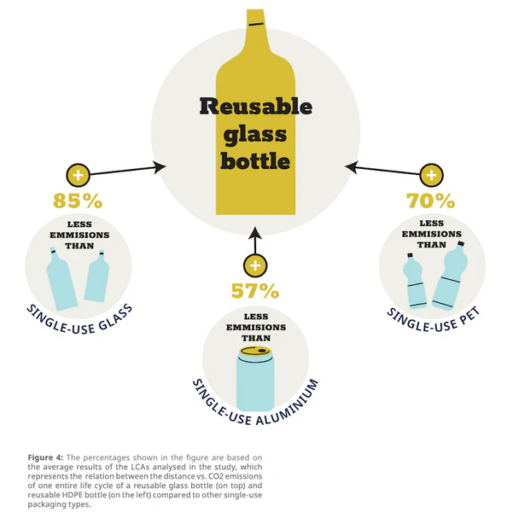
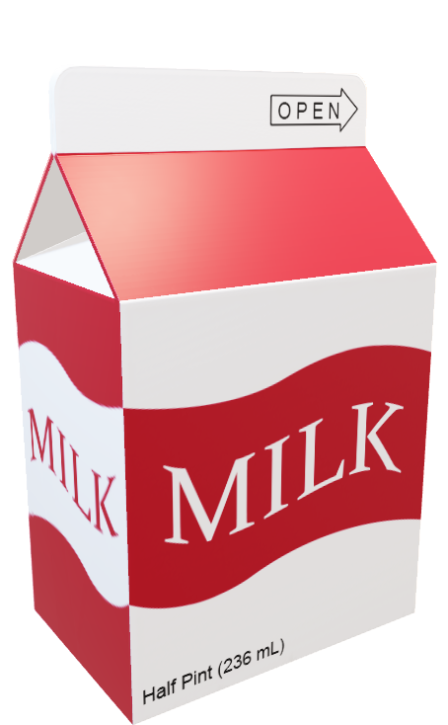
Introduction Background: We start by looking at traditional milk packaging and its impact on the environment. Importance: It’s important to find greener alternatives. Scope: We’re focusing on options that are biodegradable,recyclable, or reusable.

Slide 7
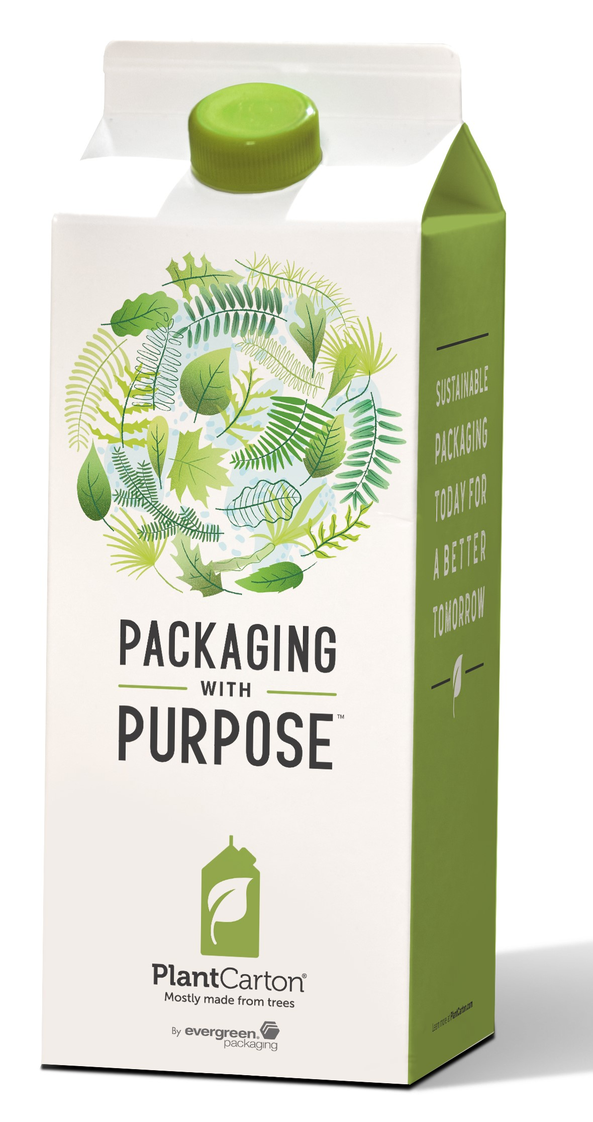
Literature Survey
Literature Survey : Existing Solutions: A look at current eco-friendly materials like bioplastics.
Gaps Identified: What’s missing in current research .
Key Studies: Important research on green packaging .

Slide 8
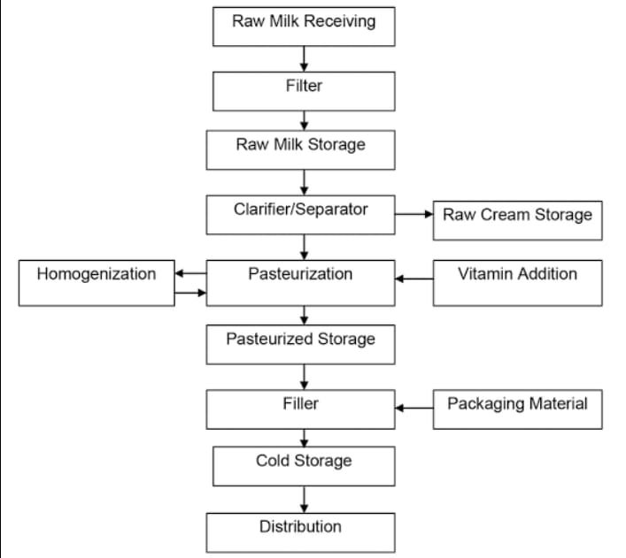
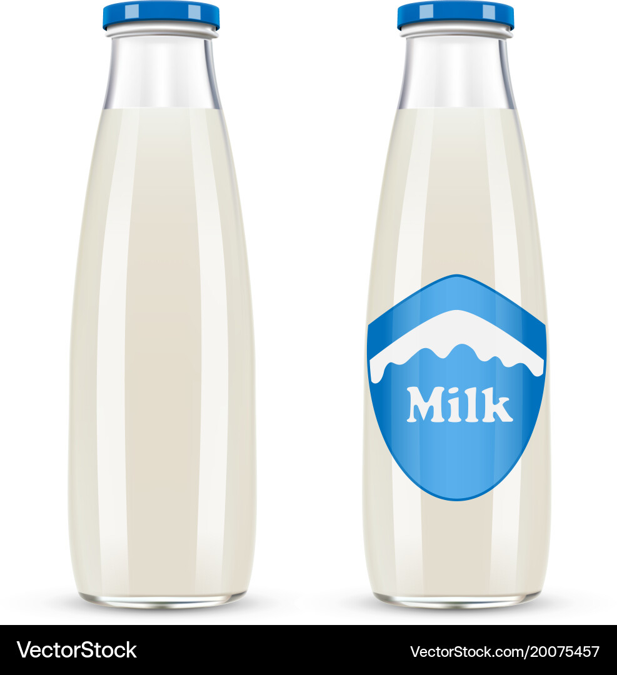
Features of Proposed Architecture system
In our exploration of green packaging solutions for milk . Here are the key concepts:
Biodegradable Packaging: Materials that decompose naturally, reducing landfill waste.
Recyclable Packaging: Designed for easy recycling to minimize the need for new resources.
Concept of Glass Bottles:
Sustainability Benefits: Glass bottles are highly recyclable and can be reused multiple times, making them an eco-friendly alternative to single-use plastics.

Slide 9
IMPLEMENTATION/TESTING
Comparative Analysis: Will compare green packaging with traditional options.
Planned Tools and Techniques : Material Analysis: To test durability, biodegradability, and recyclability.
Consumer Feedback: To gather opinions on usability and preferences.
Environmental Impact Assessment: To measure waste and emission reductions.

Slide 10
RESULT AND DISCUSSION
Recyclable Packaging:
Why It’s Good: Saves resources and energy by reusing materials.
Reusable Packaging:
What It Is: Packaging you can use multiple times.
Why It’s Good: Cuts down on single-use waste.
Watch Out For: Needs to be cleaned and maintained to stay safe.
Discussion Point: Choosing the best packaging isn’t just about what looks good on paper. Glass bottles are eco-friendly but come with higher energy costs. It’s about balancing these factors and finding what works best in real life. What’s your take—are the benefits of using glass worth the extra energy used in making and transporting it?

Slide 11
CONCLUSION
•Milk is a liquid and so requires a container at every stage.
•Packaging of milk is the technique of using appropriate containers to protect, carry, and merchandise any milk product.
•Vital link between the manufacturer andconsumer.
•Necessary for delivering convenient product

Slide 12
Resources And Refrences
Smith, J. (2023). Sustainable Packaging Solutions. GreenTech Publishing.
Johnson, M., & Lee, S. (2021). The Environmental Toll of Packaging. EcoStudies, 12(3), 112-130.* Kumar, R. (2022). Consumer Trends in Sustainable Products. Market Insights, 8(2), 34-50.Environmental Protection Agency (EPA). (2023). Sustainable Packaging Regulations. Retrieved from the EPA Website.
Green, L. (2023). Innovations in Packaging Materials. GreenTech Publishing.Brown, T. (2022). Economic Analysis of Sustainable Packaging. Journal of Environmental Economics, 20(1), 88-101.

